Slide 1
Restaurant review
Sheetal singh

Slide 2
Choice of Topic (Reason for selecting topic)
Restaurant review will cover a real world scenario, because it is something that we face every weekend
There is more scope to learn and improve
Restaurant review had more choices and options where as best buy had limited number of choices
Restaurant reviews is something every single person is relatable to even kids

Slide 3
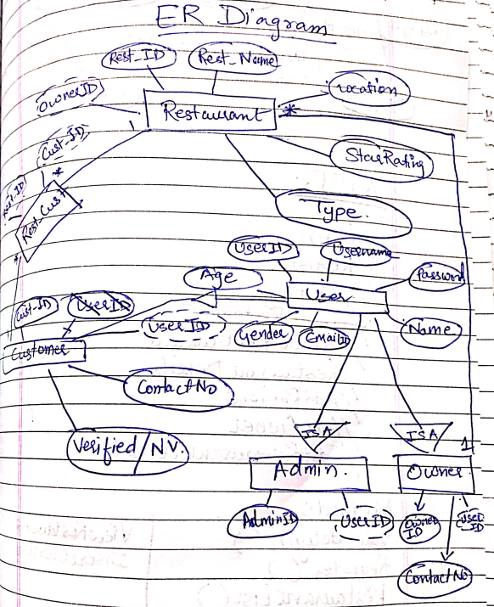

Slide 4
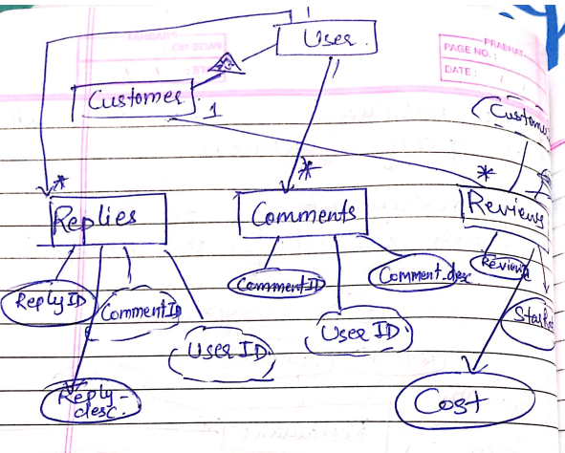

Slide 5
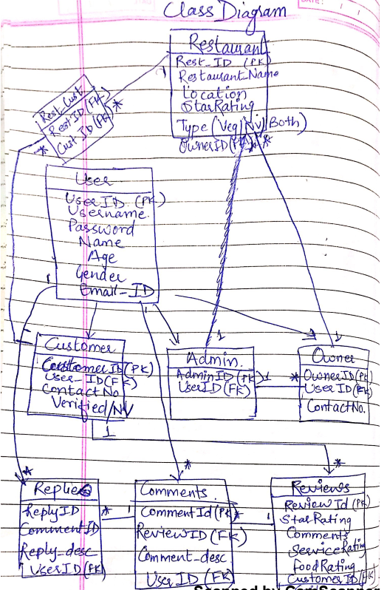

Slide 6
Application architecture
Angular JS
REST(Using Spring)
Authentication & Authorization
Spring
Service/DAO
Hibernate (Using Spring)
Hibernate Mapping ( One-to-many, One-to-one)
Database ( Primary Key, Foreign Key)

Slide 7
Application Flow- Define all roles and responsibilities
Guest -can add Reviews to restaurants.
Registered Customer
Add a new Restaurant
Add Reviews
View Existing Reviews & Replies
Customer Registration
Admin -Approves / Deletes Resturant
Adds new Restaurant and creates a Owner Account.
Owner - Register a new Restaurant
Reply to comments
View All Comments

Slide 8
THANK YOU

